Slide 1
Unicoord: scRNA Representation and Manipulation
Gao Haoxiang
2022/03/10

Slide 2

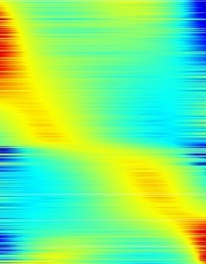
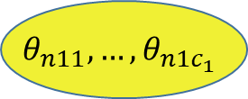
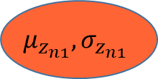
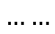
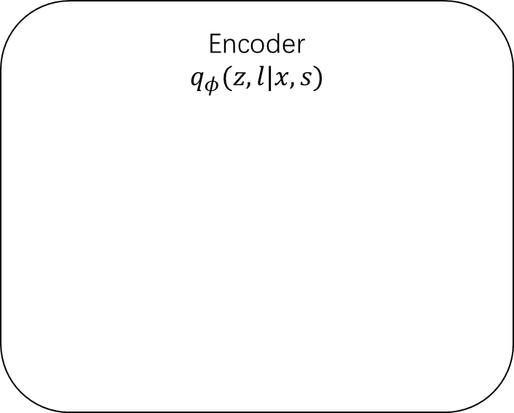
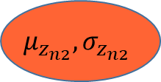
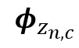
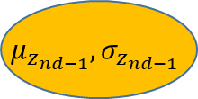
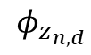
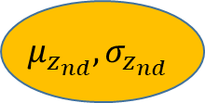
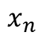
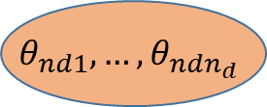
Encoder
Disc
$$θ_{n11},…,θ_{n1c_{1}}$$
Supervised
$$θ_{nd1},…,θ_{ndn_{d}}$$
Encoder
$$q_{φ}(z,l|x,s)$$
Cont
$$φ_{z_{n,d}}$$
$$μ_{z_{n1}},σ_{z_{n1}}$$
$$x_{n}$$
$$μ_{z_{n2}},σ_{z_{n2}}$$
$$……$$
$$φ_{z_{n,c}}$$
…
$${μ_{z_{nd−1}},σ}_{z_{nd−1}}$$
observed genes
unsupervised
discrete
parameters
supervised
discrete
parameters
unsupervised
continuous
parameters
supervised
continuous
parameters
$${μ_{z_{nd}},σ}_{z_{nd}}$$

Slide 3
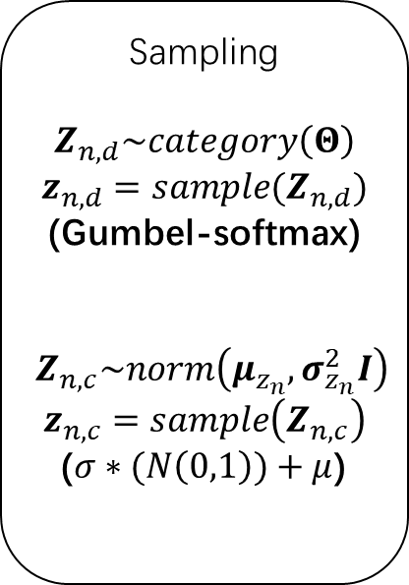
Reparameterization
Encoder
$$q_{φ}(z,l|x,s)$$
Sampling
$$Z_{n,d}\sim category\left(Θ\right)$$
$$z_{n,d}=sample(Z_{n,d})$$
(Gumbel-softmax)
$$Z_{n,c}\sim norm\left(μ_{z_{n}}, σ_{z_{n}}^{2}I\right)$$
$$z_{n,c}=sample\left(Z_{n,c}\right)$$
($σ∗(N\left(0,1\right))+μ$)
$$φ_{z_{n,d}}$$
$$x_{n}$$
$$……$$
$$φ_{z_{n,c}}$$
observed genes
unsupervised
discrete
parameters
supervised
discrete
parameters
unsupervised
continuous
parameters
supervised
continuous
parameters

Slide 4
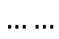
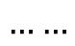
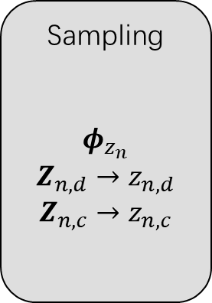
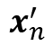
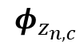
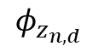
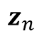
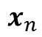
UniCoord
Labels
Batch
Pseudo-time
Cell Type
Function
score
Encoder
Decoder
$$φ_{z_{n,d}}$$
Sampling
$$φ_{z_{n}}$$
$$Z_{n,d}→z_{n,d}$$
$$Z_{n,c}→z_{n,c}$$
$$z_{n}$$
$$……$$
$$x_{n}$$
$$……$$
$$x_{n}^{′}$$
$$φ_{z_{n,c}}$$
observed genes
unsupervised
discrete
parameters
supervised
discrete
parameters
unsupervised
continuous
parameters
supervised
continuous
parameters
Supervise

Slide 5
Universal Coordinate Method
Continuous
PCA
VAE
UniCoord
Regression
MLP
Unsupervised
Supervised
Kmeans
Louvain
SVM
Random Forest
Discrete

Slide 6
Current Works
API to Scanpy
Create model
Train model
Get embedding
Predict labels
Generate data
Write & Load h5ad
Cross-dataset Prediction
hECA all
hECA lung
Lung cancer
Liver cancer
Cell manipulation
Change cell type
Change batch/organ
Change trajectory
Change function

Slide 7
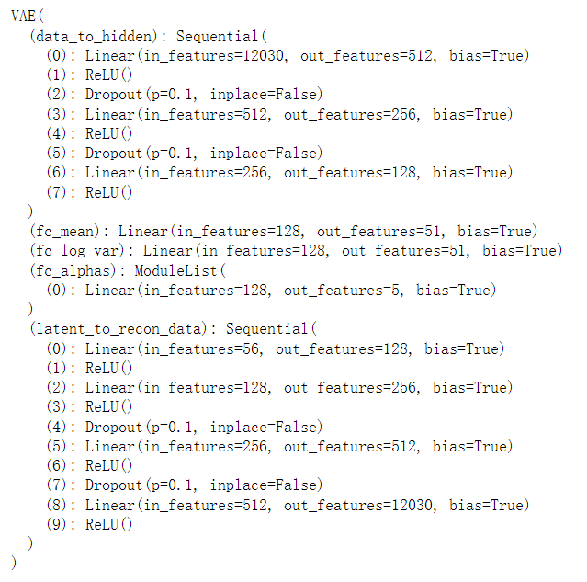
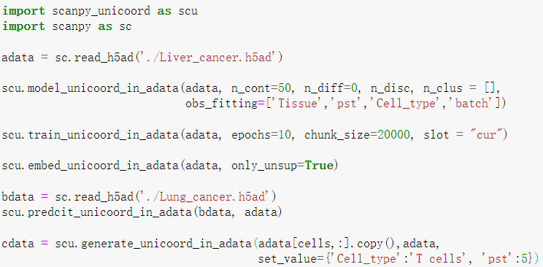
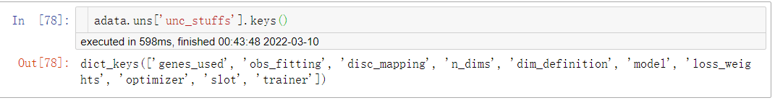
API to Scanpy - build model
2s

Slide 8
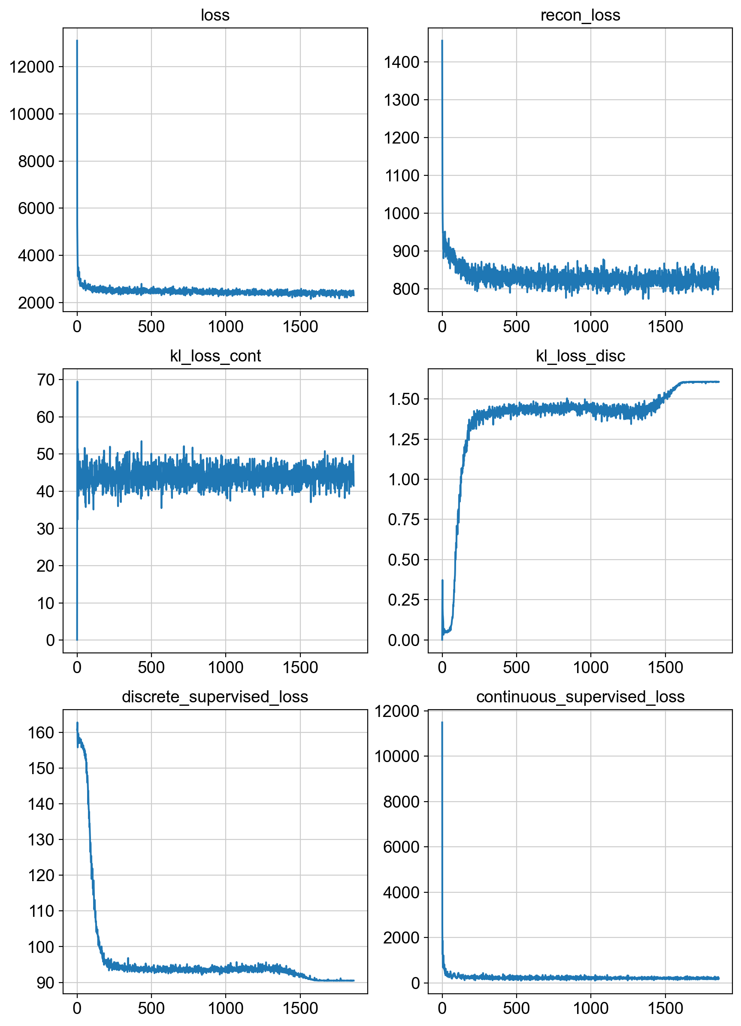
API to Scanpy - train model
10s/10000cells/epoch

Slide 9
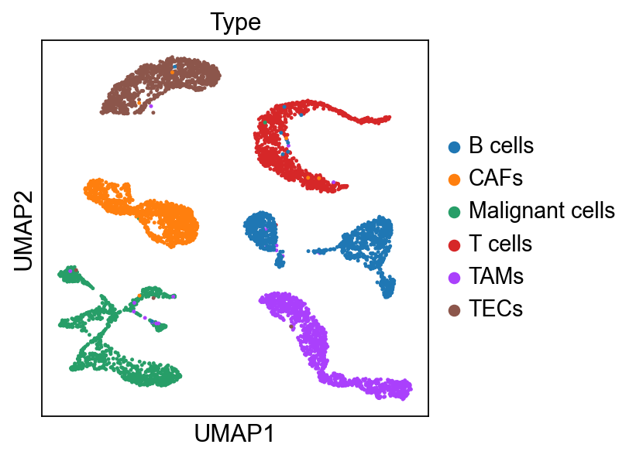
API to Scanpy - embed
1.5s/10000cells

Slide 10
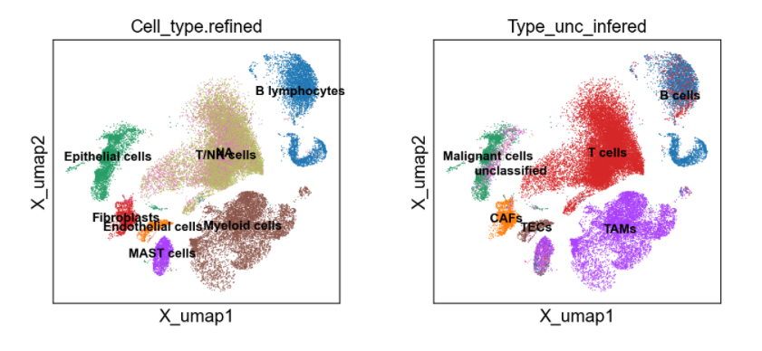
API to Scanpy - predict
4s/10000cells

Slide 11
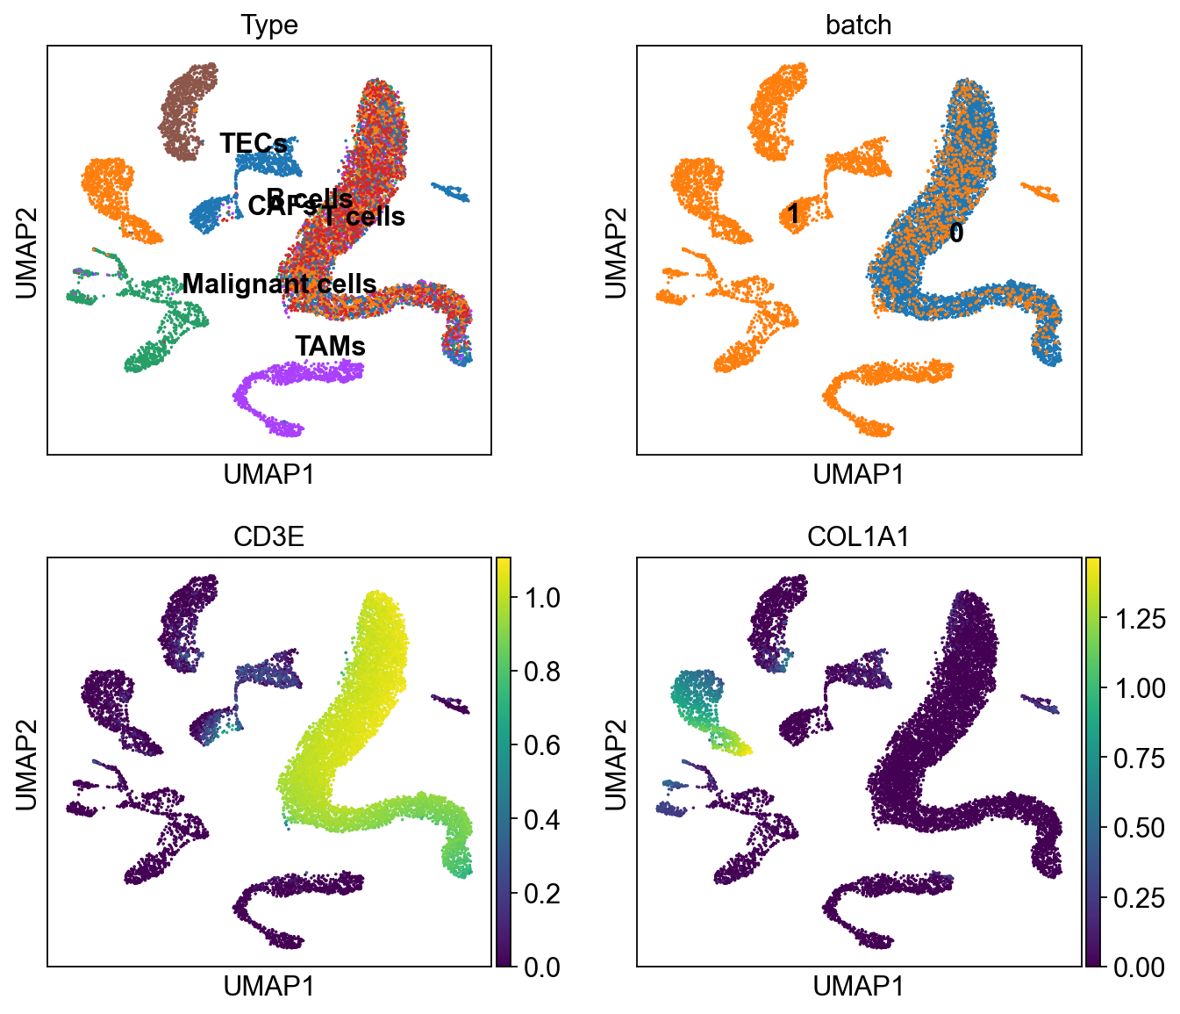
API to Scanpy - generate
native
3s/10000cells

Slide 12
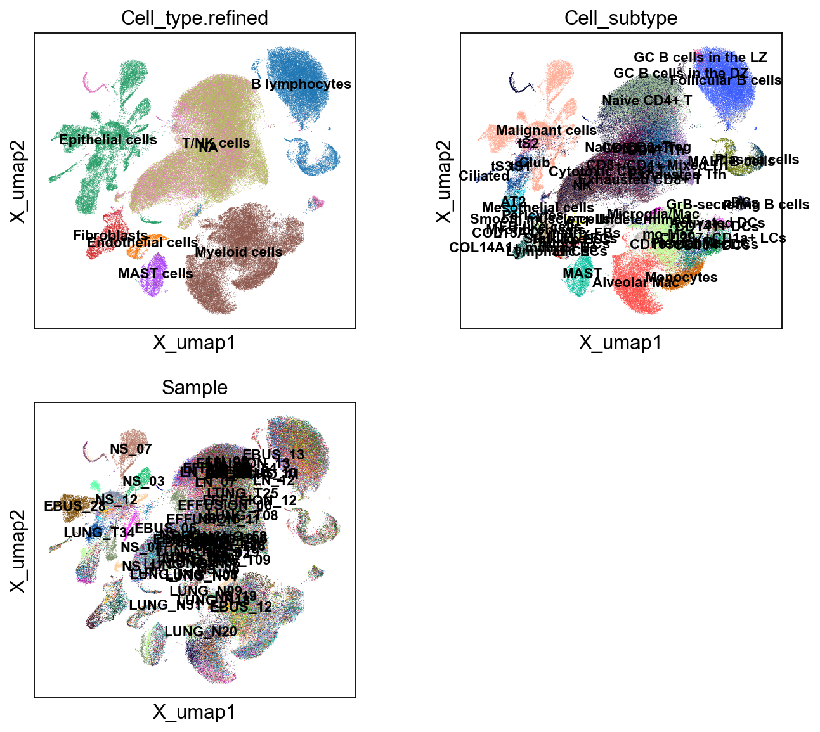
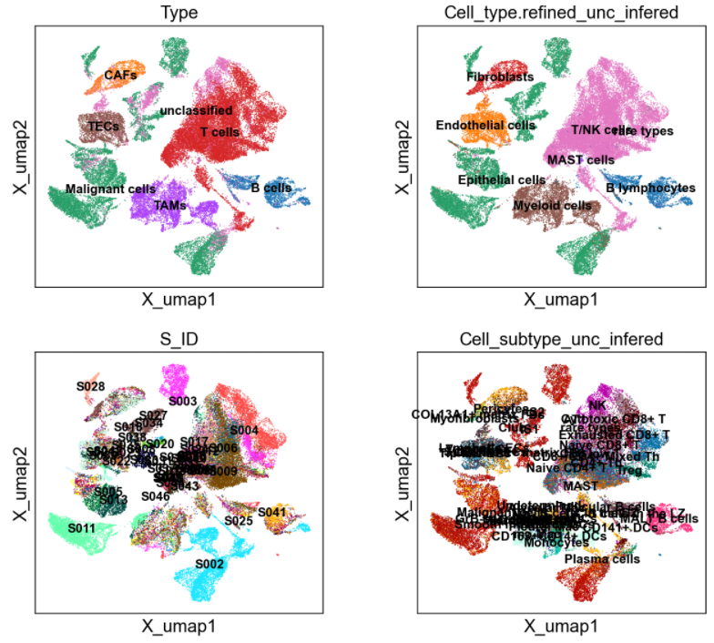
Prediction across Datasets
LUAD
HCC
Acc = 0.95

Slide 13
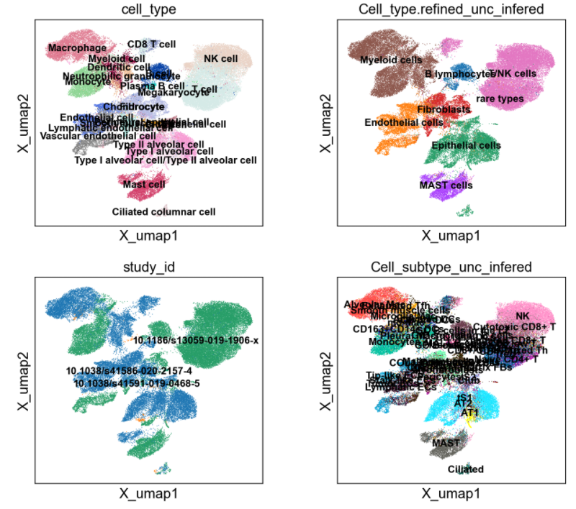
Prediction across Datasets
LUAD
hECA lung
Acc = 0.95

Slide 14
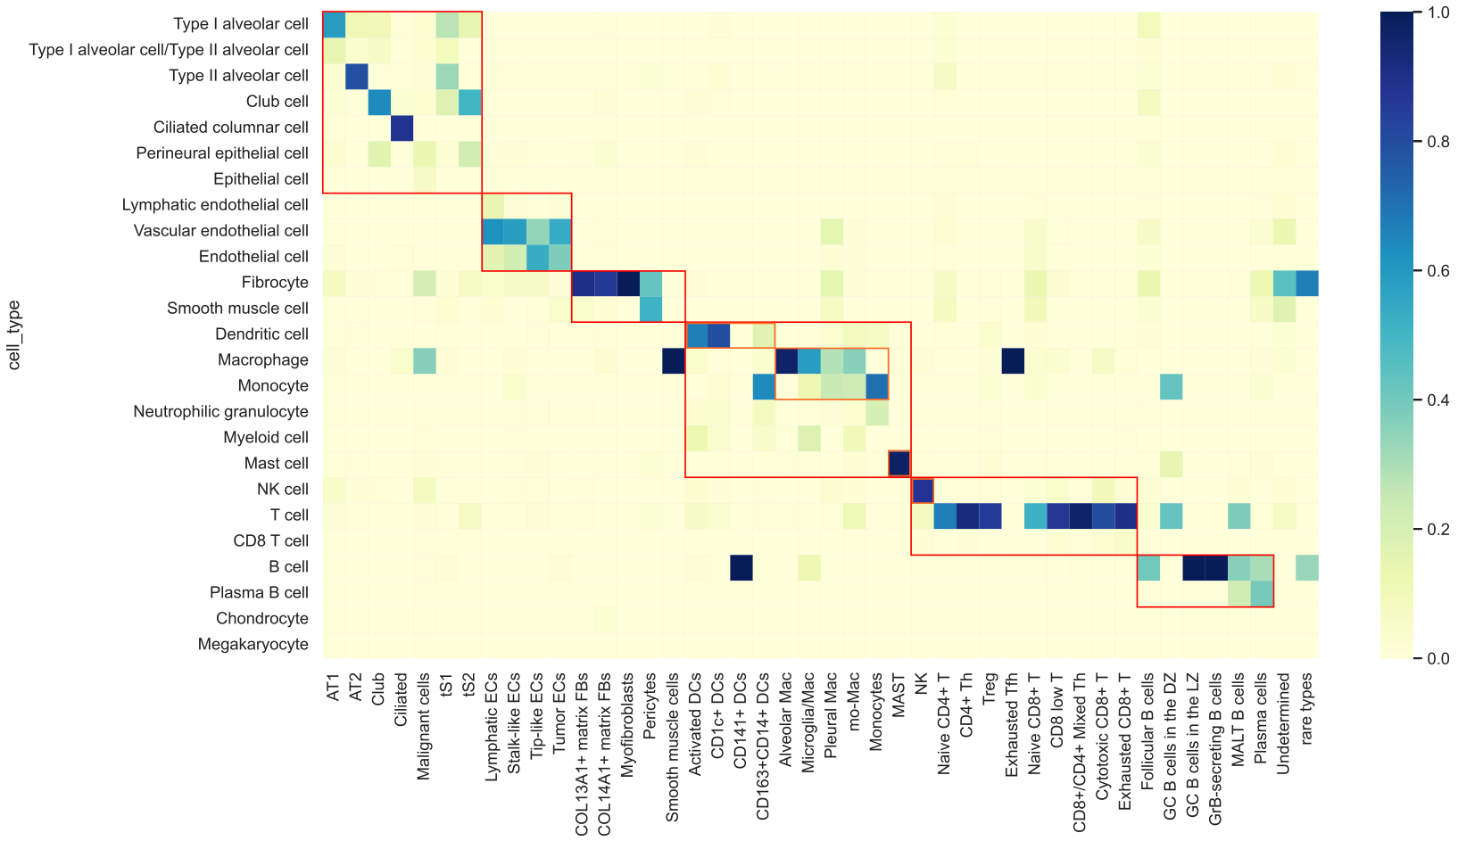
hECA lung
Acc = 0.95
LUAD

Slide 15
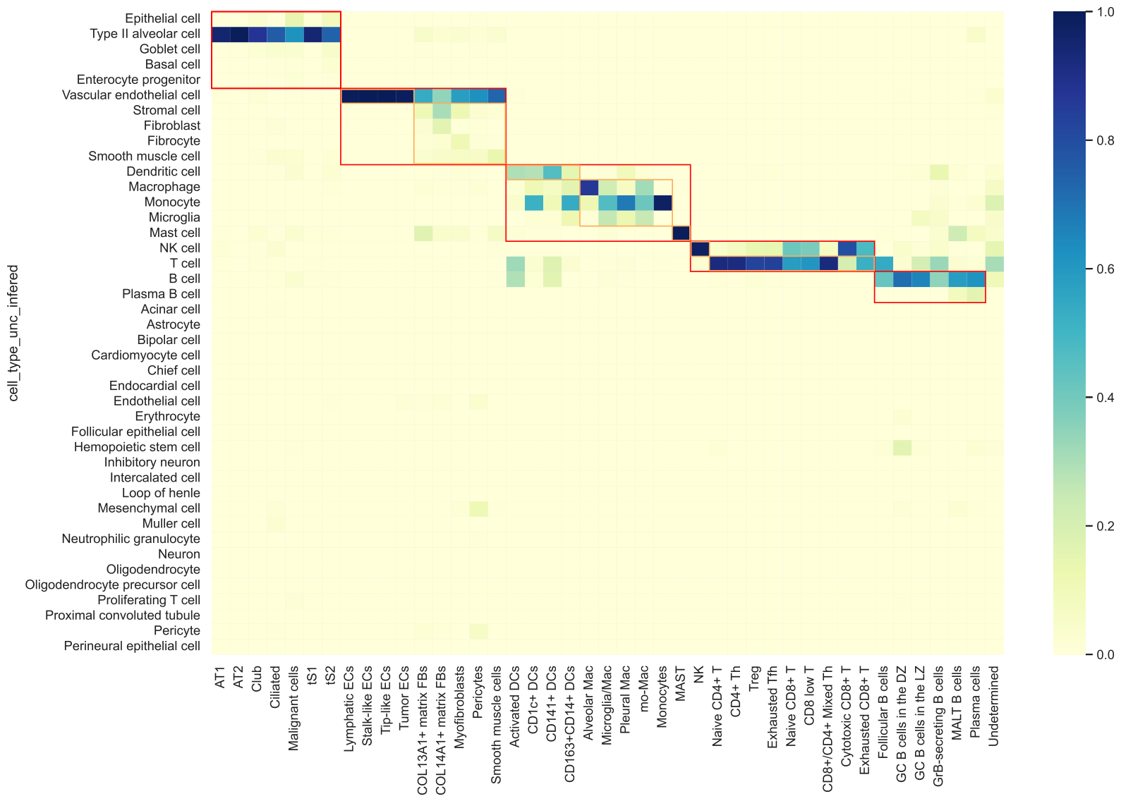
hECA all
Acc = 0.85
LUAD

Slide 16
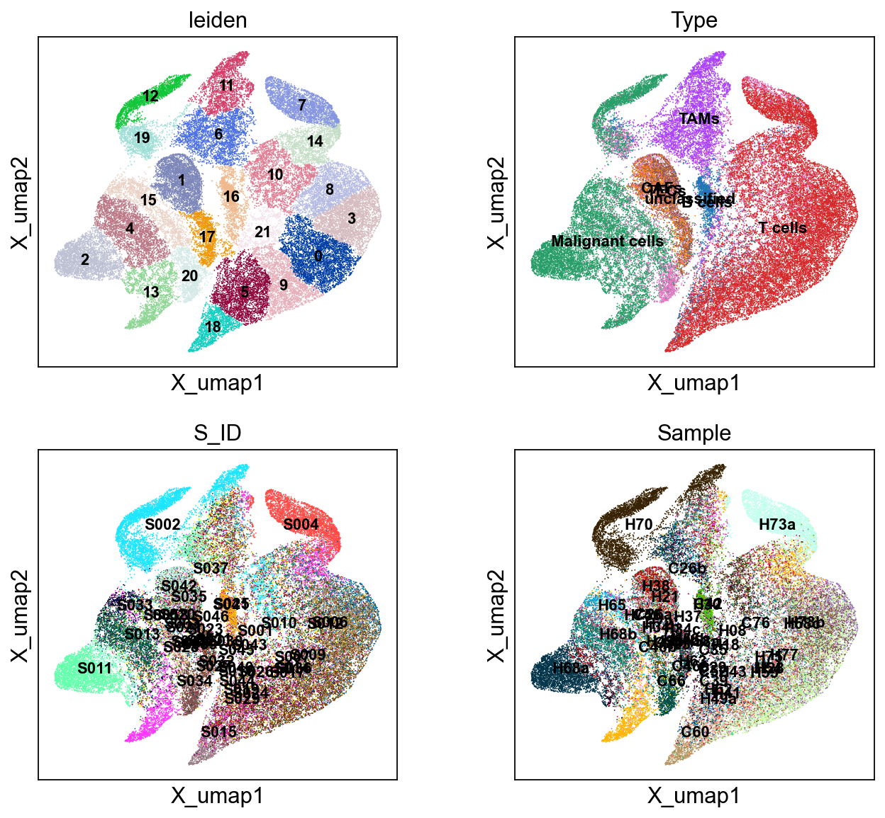
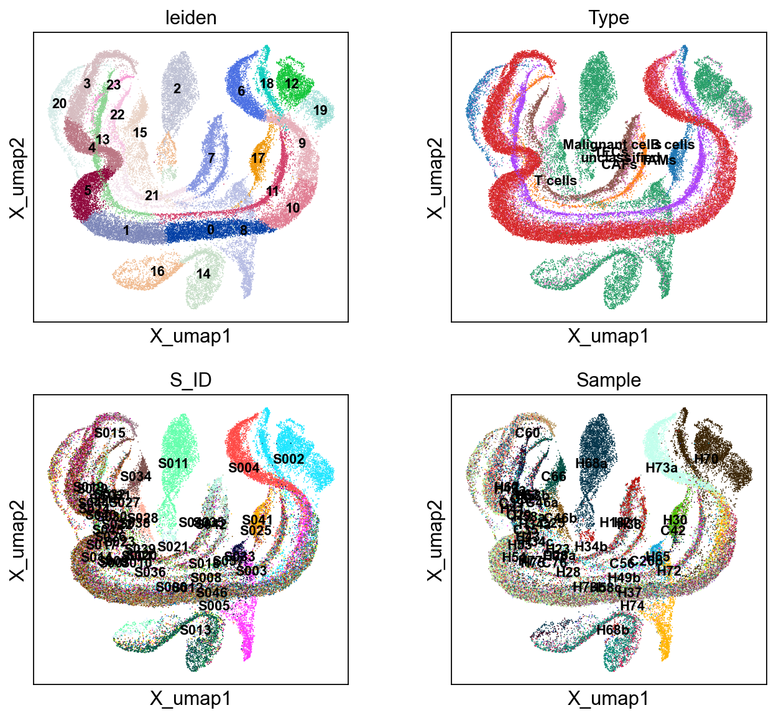
Cell manipulation
X
Encoder
Change batch/organ
Change cell type
Change trajectory
Change function
sup
unsup
disentangled
X’
Decoder

Slide 17
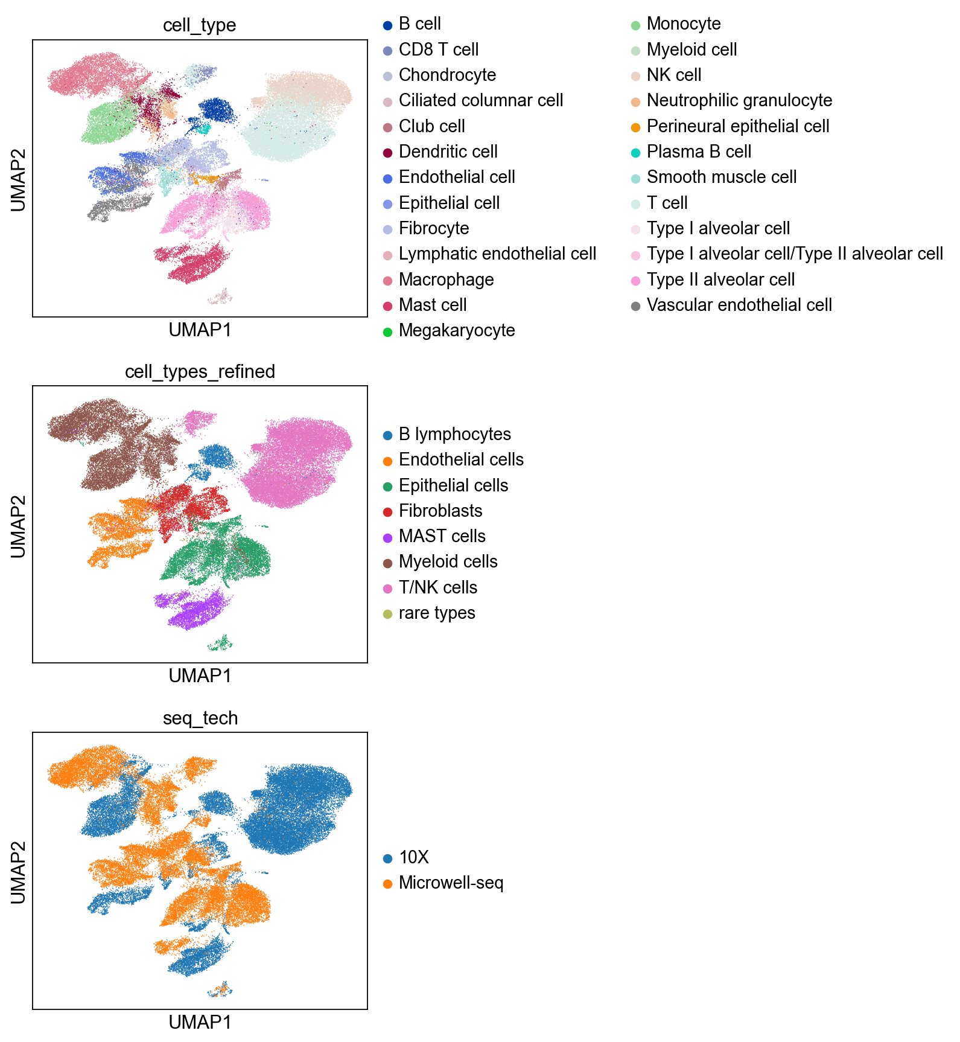
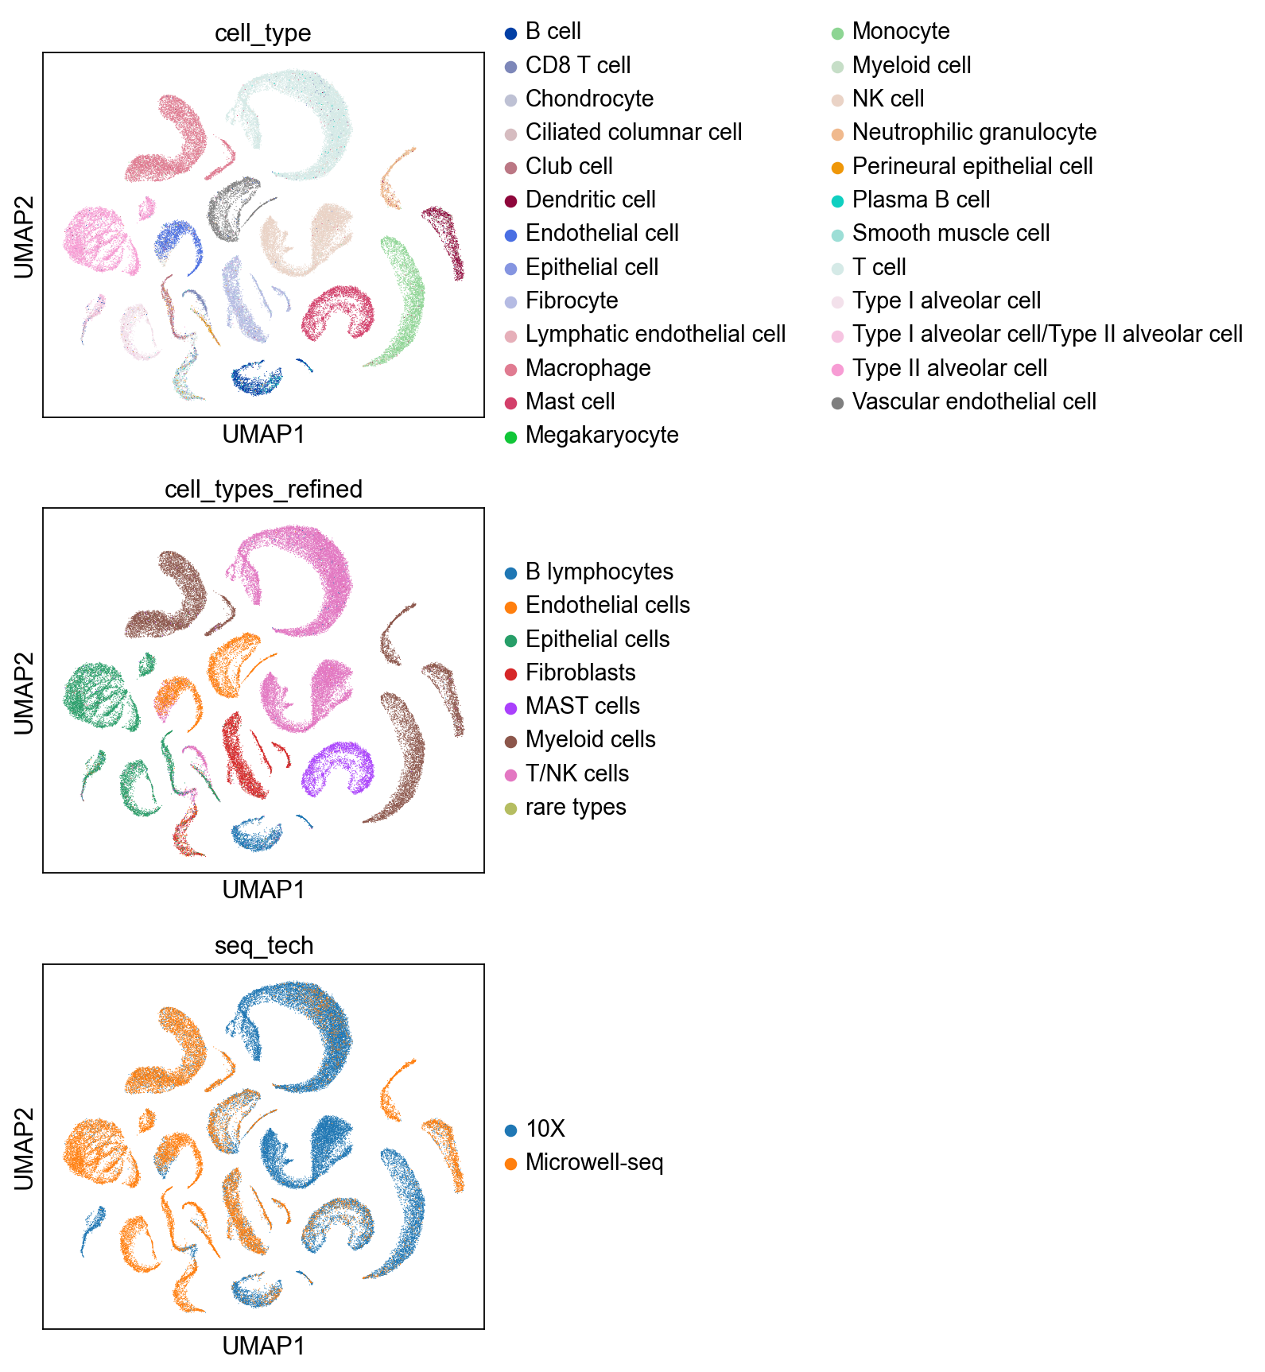
hECA lung
Changing batch ident can remove batch effect

Slide 18
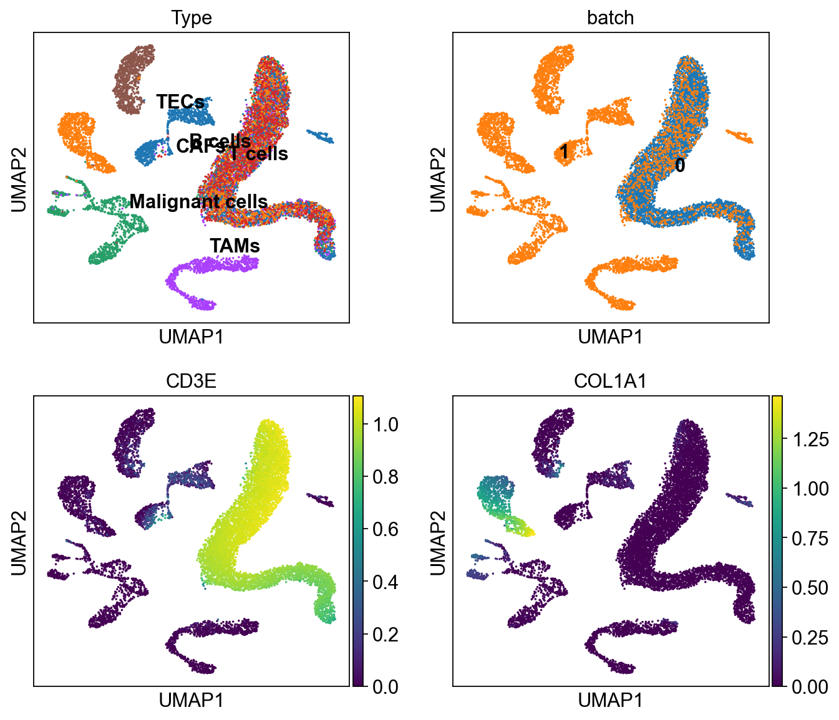
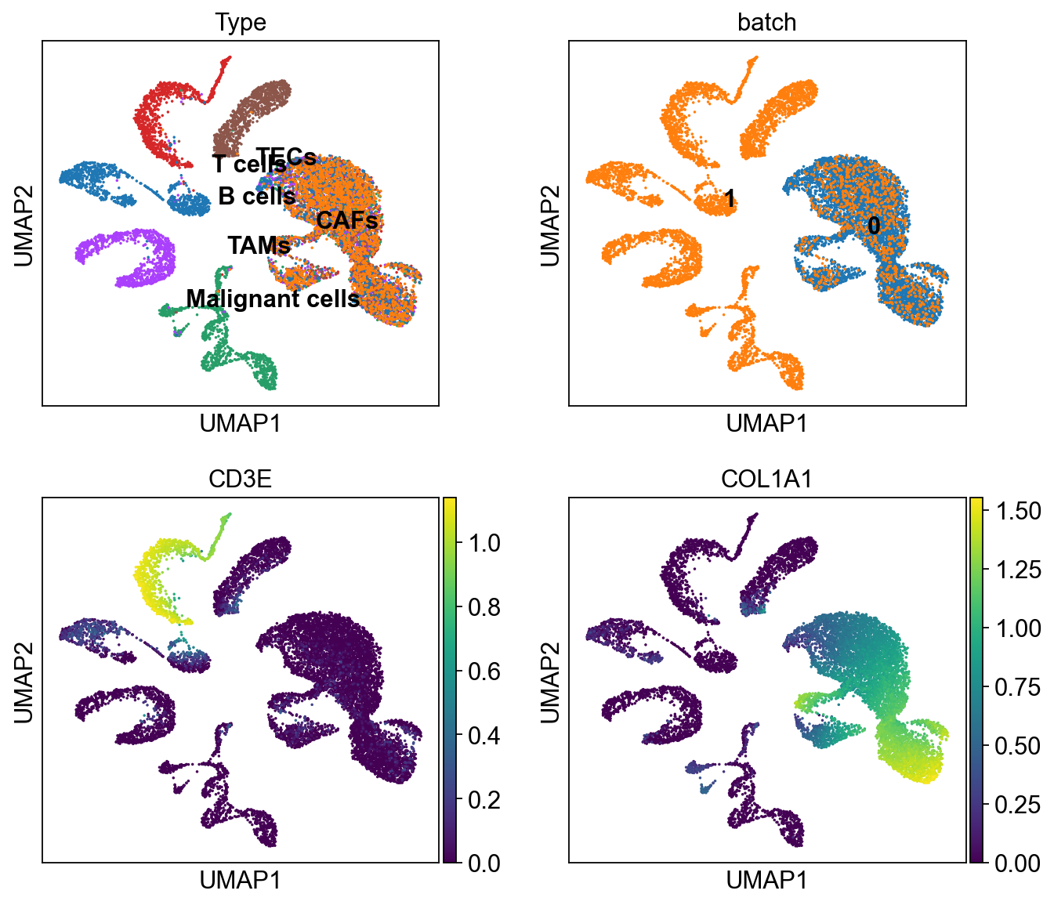
Cell Manipulation - change cell type

Slide 19
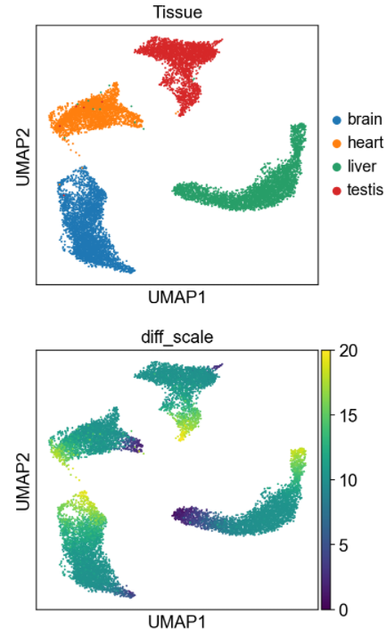
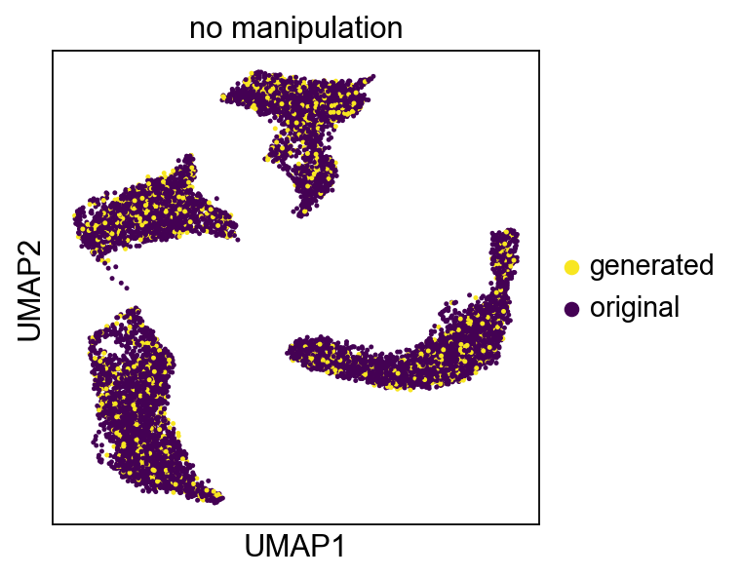
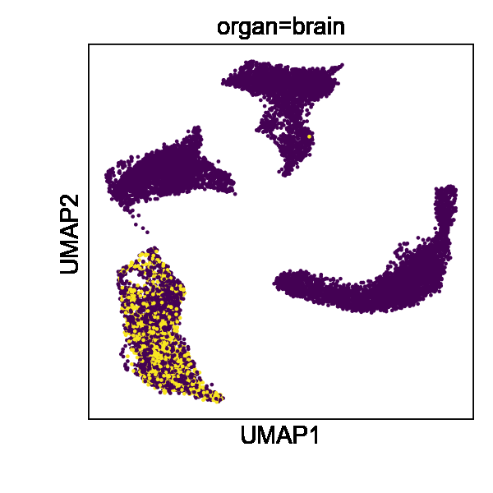
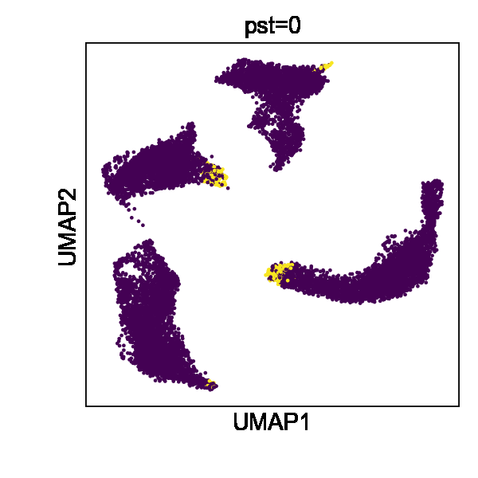
pst
Mouse Endothelial Cells
Organs
Trajectory

Slide 20
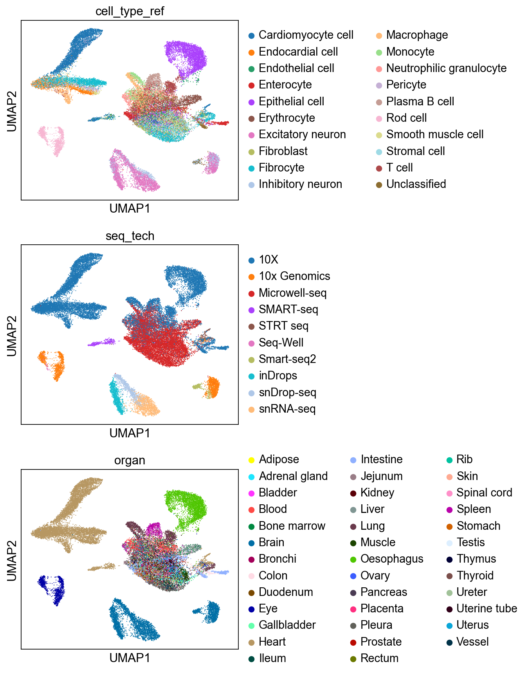
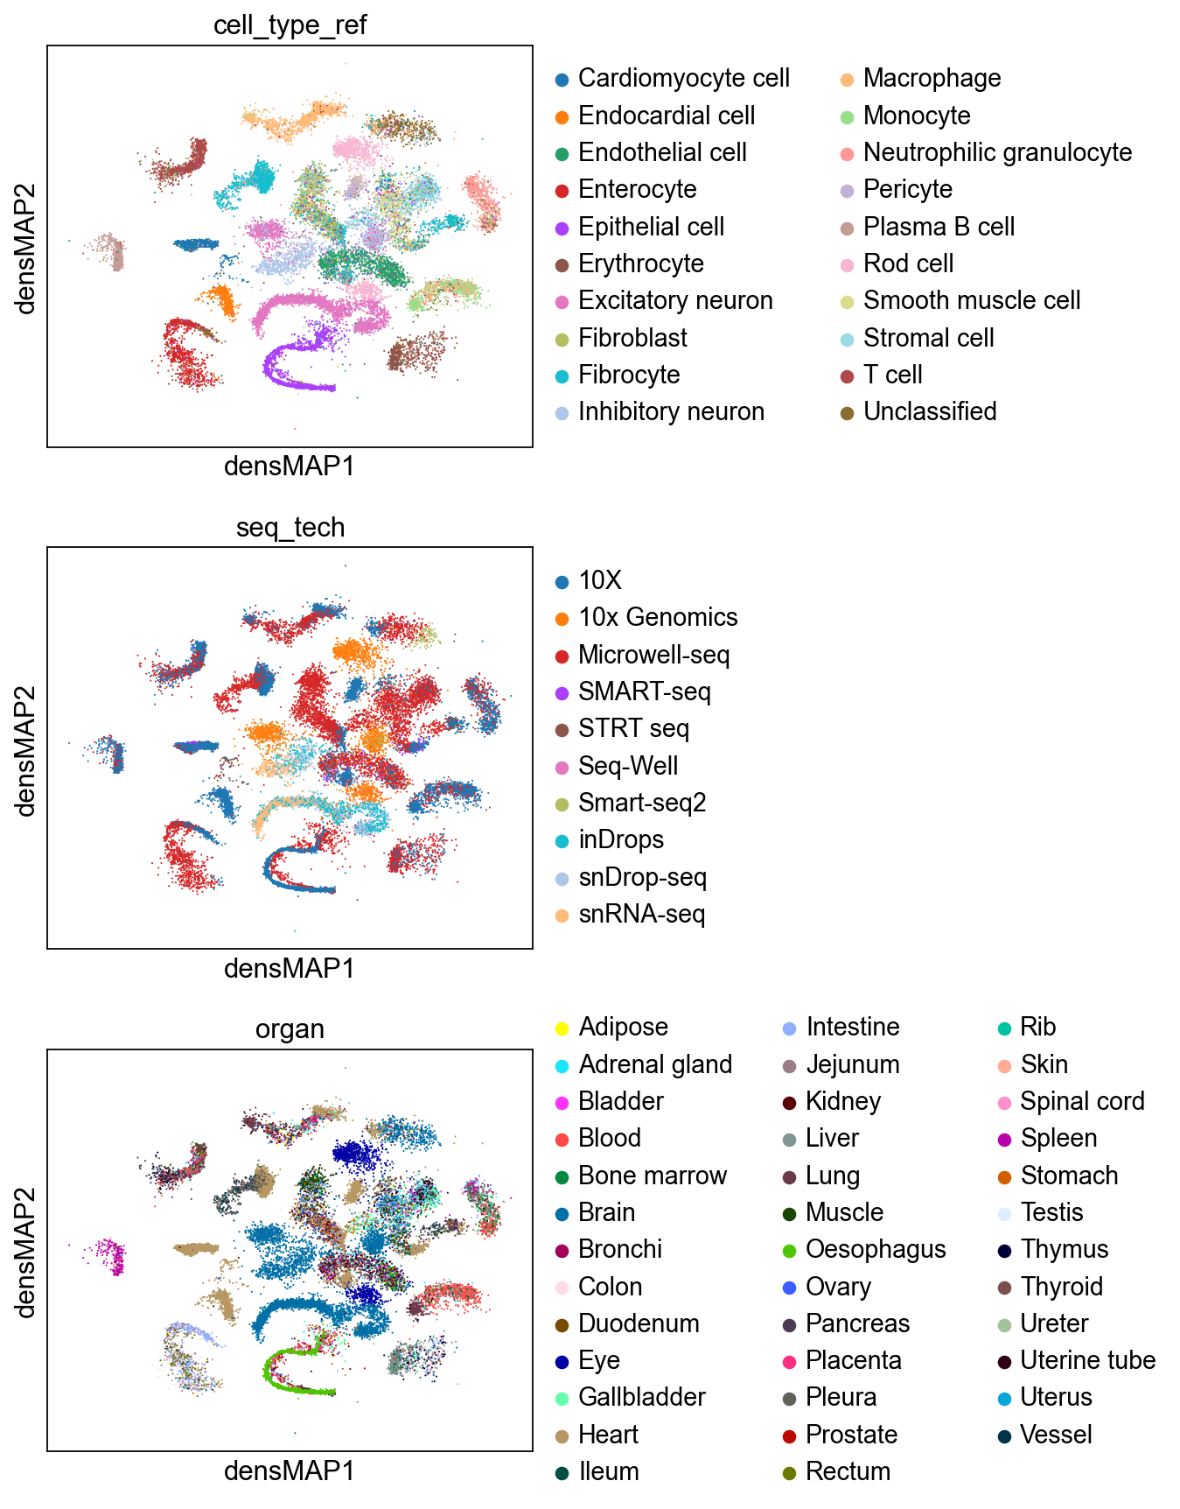
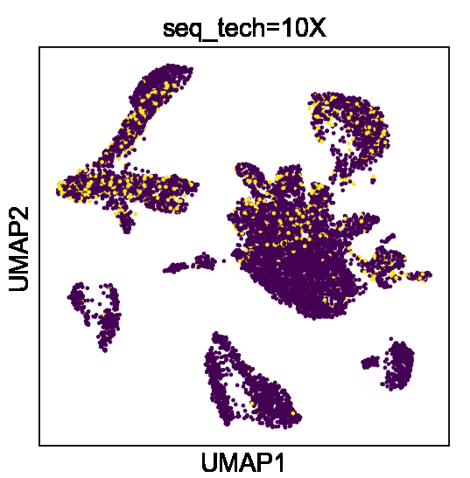
hECA all

Slide 21
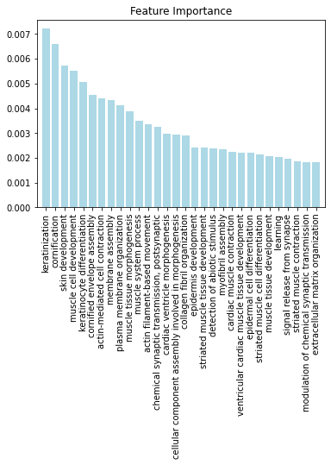
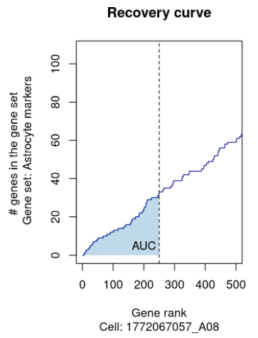

GOBP Score as Latent Representation
30 most important BPs
2,800 GOBP AUCell scores for
50,000 hECA cells
Cell types

Slide 22
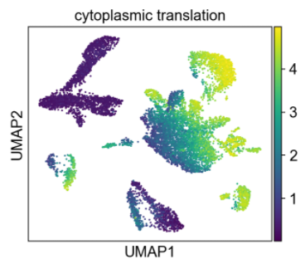
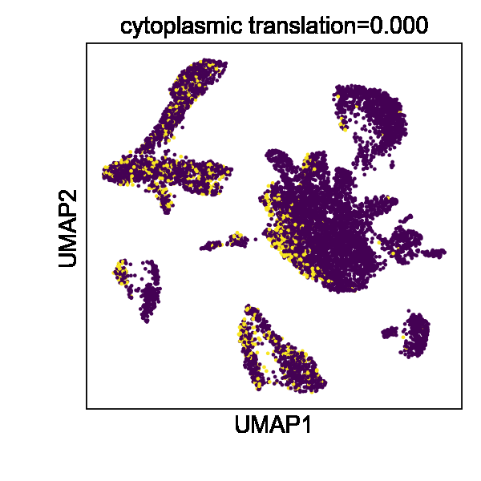





Cardiomyocyte
Epithelial cells

Slide 23
Summary
UniCoord is an easy to use, pretty fast, end-to-end tools for analyzing scRNA-seq data
Compatible with Scanpy, 5 functions
Trained in minutes and used in seconds
Robust and efficient label transfer
Interpretable and disentangle representation allows manipulation of cells, you can:
Change batch/seq_tech/patient: batch effect removal
Change organ/tissue/cell_type: what if muscle cells are in brain
Change pseudo-time/function: corresponding DEGs, cell state change
Change ?

Slide 24
THANKS

Slide 25




eye morphogenesis (in cone cells)
presynaptic endocytosis (in neurons)

Slide 26









Loss Functions
$$\left.L_{recons}=MSE(x_{n}^{′},x_{n}\right)$$
$$L_{GaussianKL}=\frac{1}{n}\sum_{n,c}{\left.KL(N\left(μ_{nc},σ_{nc}^{2}\right),N(0,1)\right)}$$
$$L_{CategoryKL}=\frac{1}{n}\sum_{n,d}{KL(Cat\left(Θ_{n,d}\right),Cat\left(\frac{1}{N_{d}}\right))}$$
$$L_{Diffusion}=\frac{1}{n}\sum_{n}{MSE(x_{n_{knn}}^{′},x_{n})}$$
$$L_{Clustering}=\frac{1}{n}\sum_{n}{S_{within}^{2}−S_{between}^{2}}$$
$$L_{Regression}=\frac{1}{n}∑MSE(μ_{Z_{n,c}},label)$$
$$L_{Classification}=\frac{1}{n}∑ARI(Θ_{n,d},label_{d})$$
$$L_{Tree}=\sum_{l}{Tree_{l−1,l}∗Cooccur(Θ_{l−1},Θ_{l})}$$

